Slide 1
Cyclistic Usage Analysis
Presented by: Vladislav Leskovetc
Last updated: October 3rd, 2021

Slide 2

Table of contents
Purpose statement (main objective)
Data analysis results
Conclusions
Recommendations
Appendix

Slide 3
Objective
Identify the differences in Cyclistic bikes usage between members and casual riders to provide Executive Team with recommendations to create marketing campaign to attract new members

Slide 4
Data used for analysis
Monthly trip data provided by Divvy
Analyzing data from 2019 (due to ongoing COVID19 pandemic that started March 2020)
Patterns identified in this analysis persist in 2020 as well, however it is less pronounced.
2020 comparison charts are provided in an Appendix

Slide 5
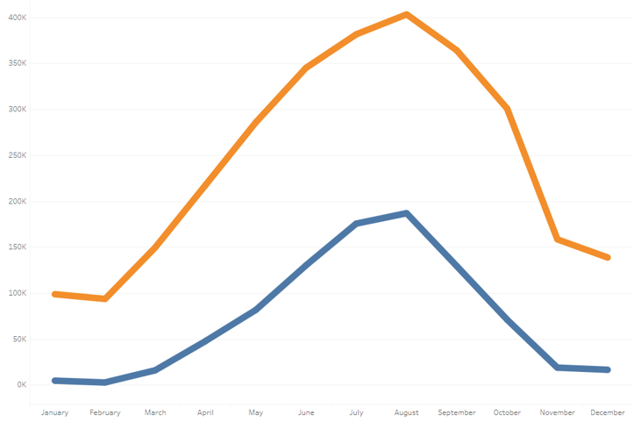
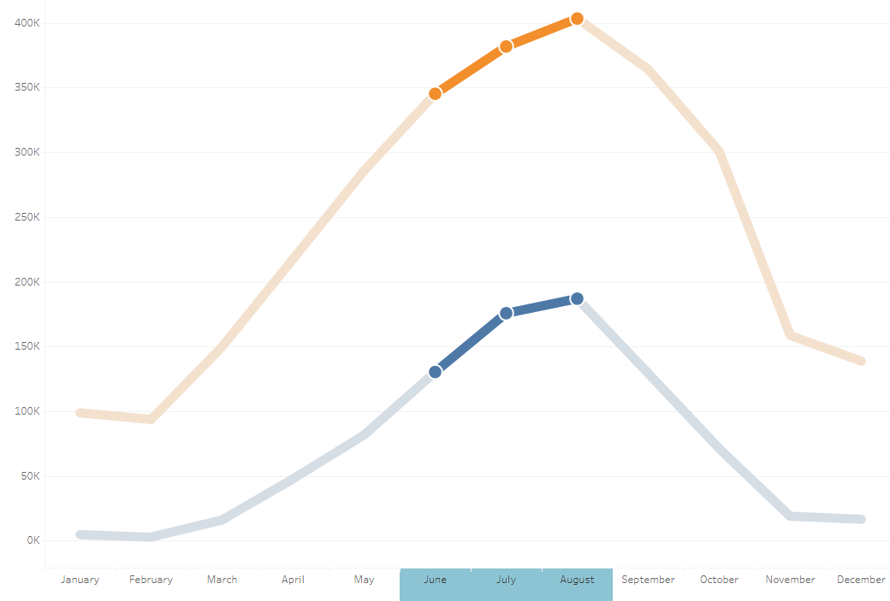
Service usage in 2019
Service usage in 2019 by member
A total of 3.8M trips were completed in 2019
43% of all trips were completed during the summer months (June, July, August)
Members completed 77% of trips (2.9M)
Finance analysts have concluded that annual members are more profitable than casual riders
43% of trips
Members
Casual

Slide 6
2019 usage indicators
Cyclistic usage by duration is evenly split between members and casual riders.
Busiest day for members is Tuesday, whereas casual rode the most on Saturday
User Type | Number of Trips | % | Total Duration (min) | % | Mean Duration (min) | Busiest Day
member | 2,937,350 | 77% | 41,878,129 | 46% | 14 | Tuesday
casual | 880,593 | 23% | 48,938,763 | 54% | 56 | Saturday

Slide 7
Hypothesis
Members use Cyclistic bike sharing service predominantly for commute while casual riders use the service for primarily for recreation.
To investigate the hypothesis, we will look into the following data points:
Number of trips per weekday
Number of trips per start time
Trip duration patterns
Correlation between time, day of the week and the number of trips
Trips distribution by location

Slide 8
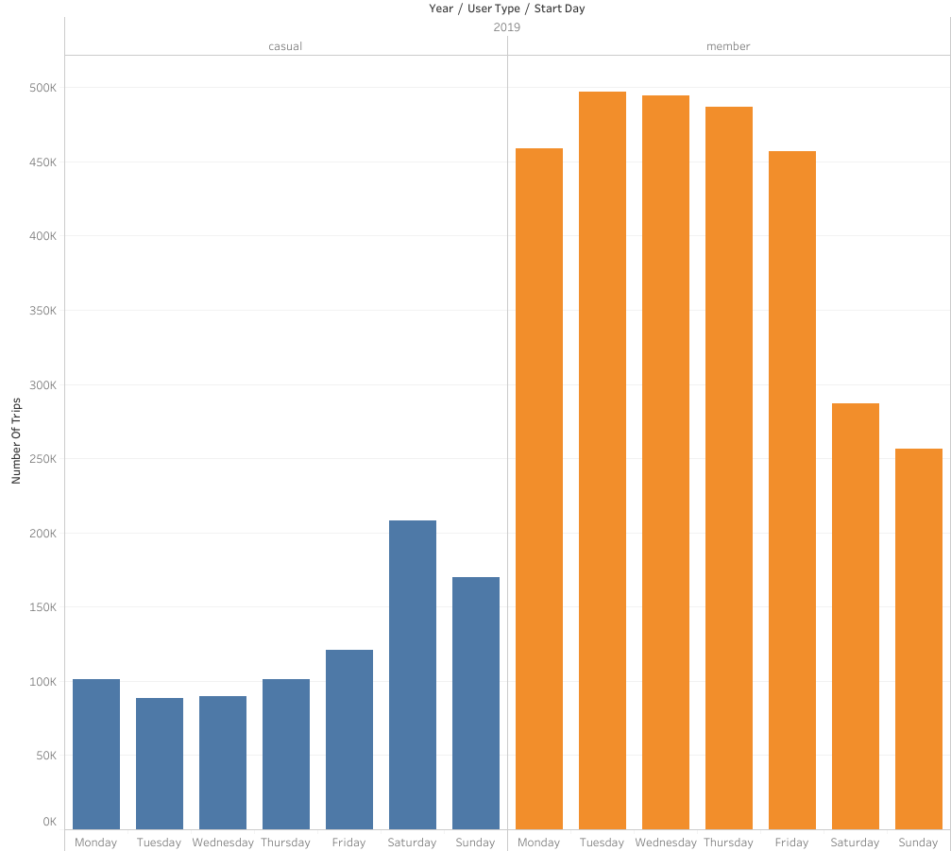
Number of trips
Number of Trips Per Weekday in 2019
82%
Members started 82% of trips during the workweek
Number of trips started by members remains stable throughout the workweek
Casual riders started 57% of trips during the workweek
Service utilization by casual riders steadily increases during the workweek, peaking on Saturday
18%
43%
57%

Slide 9
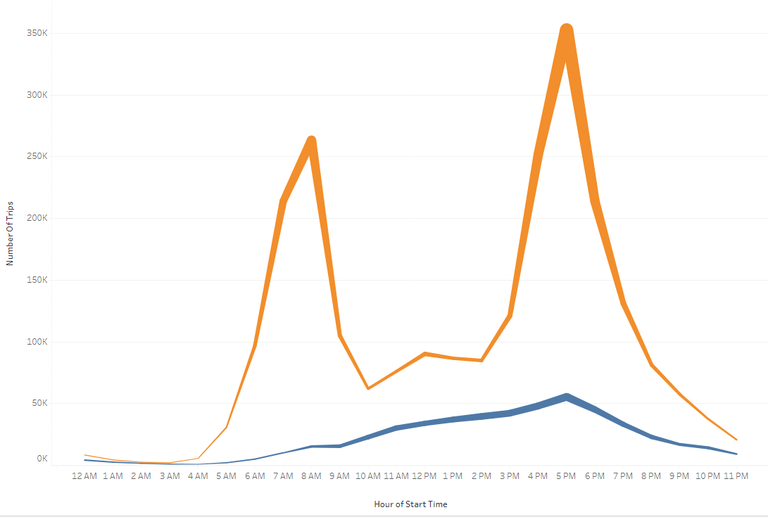
Workweek usage
Workweek Usage by Hour in 2019
Number of trips
Members
Casual
Time of day

Slide 10
Workweek usage
Workweek Usage by Hour in 2019
Members’ usage peaks at 8AM and then at 5PM
Members started 37% during the busiest times (7AM-9AM, 4PM-6PM)
Casual riders’ trips experience a steady increase from 5AM to 5PM and then slow down by 11PM
Members
Casual

Slide 11
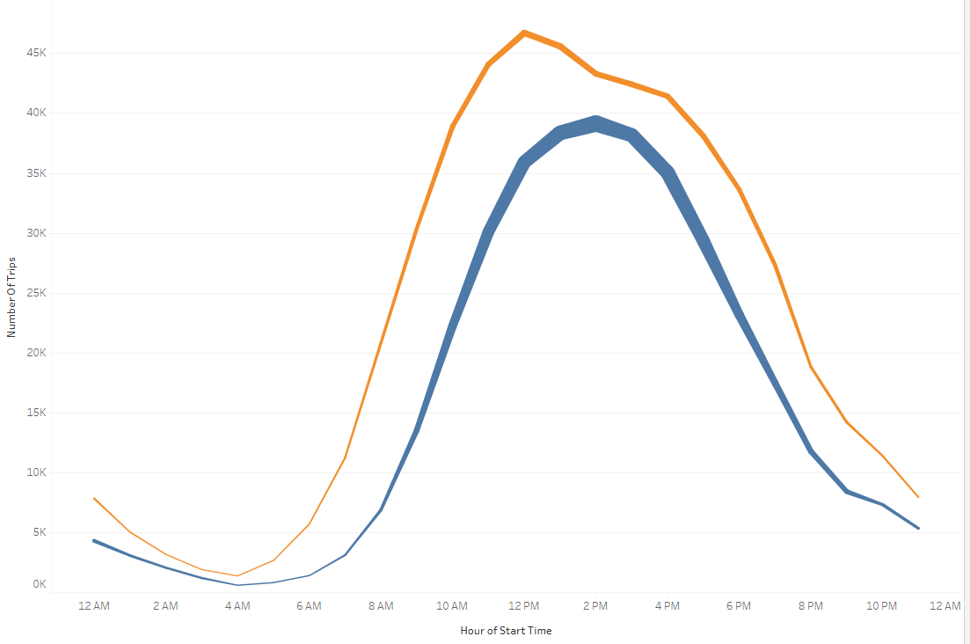
Weekend usage
Weekend Usage by Hour in 2019
Members and casual riders usage patterns are identical during the weekend
Members
Casual

Slide 12
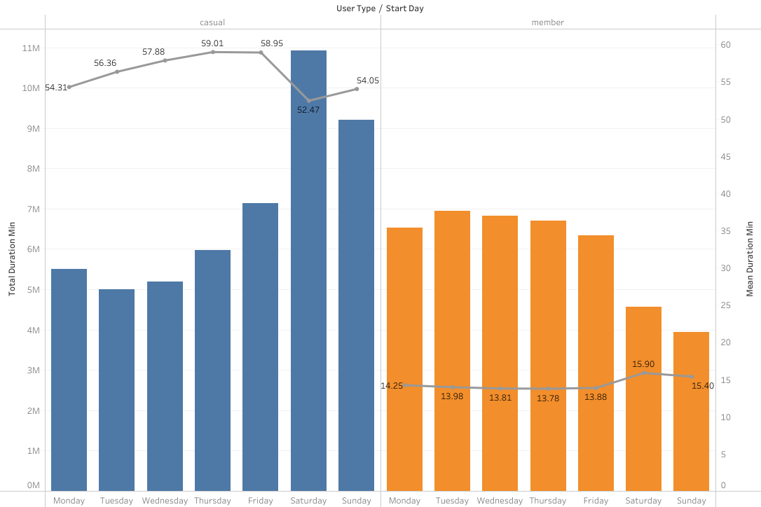
Trip duration
Total and Mean Trip Duration by Day of the Week in 2019
Trip duration
Mean duration
Mean duration
Day of the week

Slide 13
Trip duration
Total and Mean Trip Duration by Day of the Week in 2019
Total trip length is increasing for casual riders throughout the week, peaking on Saturday
Trip length for members remains stable Monday through Friday, and decreases during the weekend
On average members ride 42 minutes less than casual riders
Mean duration

Slide 14
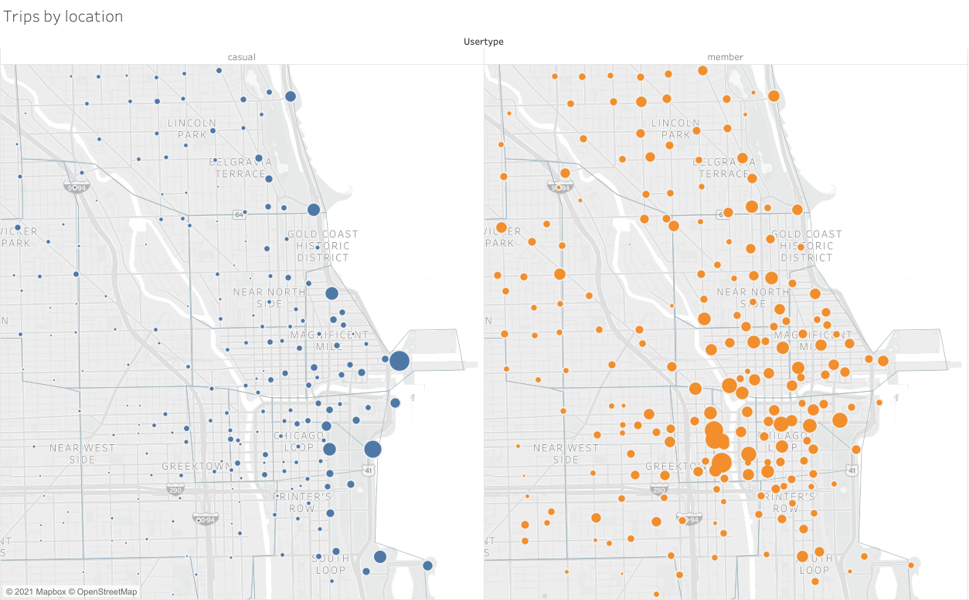
Geographical distribution
Station location

Slide 15
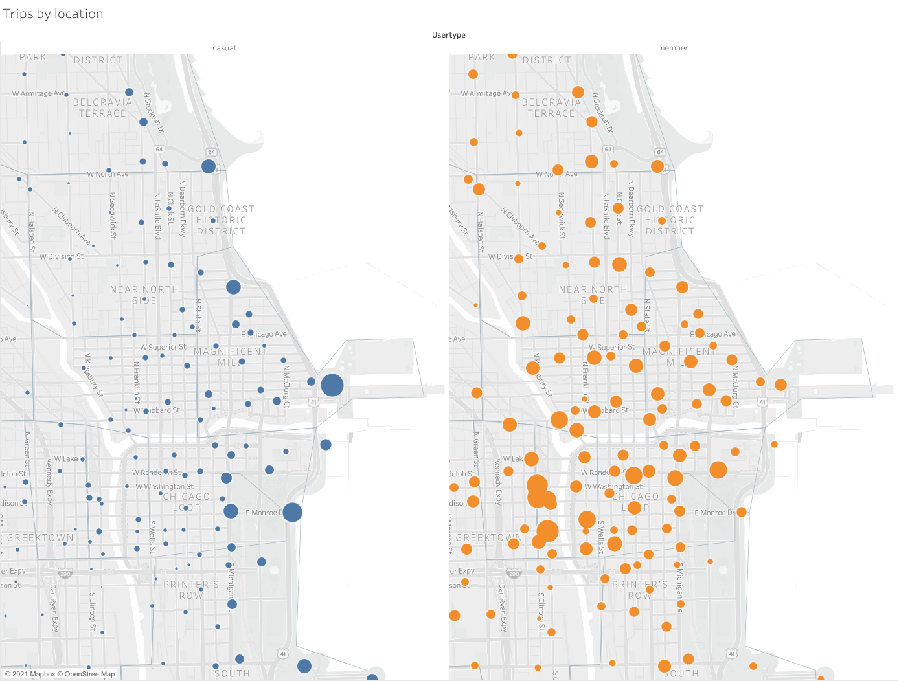
Geographical distribution
Location of Stations Where Trips are Being Started by User Type in 2019
Casual riders’ trips gravitate towards the shoreline
Casual riders started most trips at the Streeter Dr and Grand Ave location at the Pier
Members trips evenly distributed in downtown
Members started most trips at the Greektown area
Historic District, Pier, Magnificent mile
Greektown
Pier station

Slide 16
Conclusions
Members average ride length is 42 minutes lower than the casual riders
Members’ start locations are more equally distributed around town
*Evidence suggests that members use service primarily for work commute, whereas casual riders use it as leisure activity
*Does not mean there are no other use cases, further analysis is needed
Busiest time of day for Members is at 8AM and 5PM during work week
Casual riders tend to start their trips in the more scenic area on the shoreline
Busiest time of day for casual riders is between 12PM and 3PM on weekends

Slide 17
Recommendations
Conduct a survey among members and casual riders to identify their preferences and use cases for the service
Conduct a separate analysis focusing on impact of COVID 19
Provide incentives for current casual members to convert to members
Work with the Universities in Chicago area to subsidize discounted membership for students, faculty, and staff
Send monthly newsletter to current members showing how their usage of bike sharing for commuting helps the environment

Slide 18
Thank you!

Slide 19
Appendix 1: Usage indicators 2020
Year | User Type | Number of Trips | % | Total Duration (min) | % | Mean Duration (min) | Busiest Day
2019 | member | 2,937,350 | 77% | 41,878,129 | 46% | 14 | Tuesday
2019 | casual | 880,593 | 23% | 48,938,763 | 54% | 56 | Saturday
2020 | member | 2,162,605 | 61% | 34,123,260 | 35% | 16 | Wednesday
2020 | casual | 1,359,813 | 39% | 64,648,316 | 65% | 48 | Saturday

Slide 20
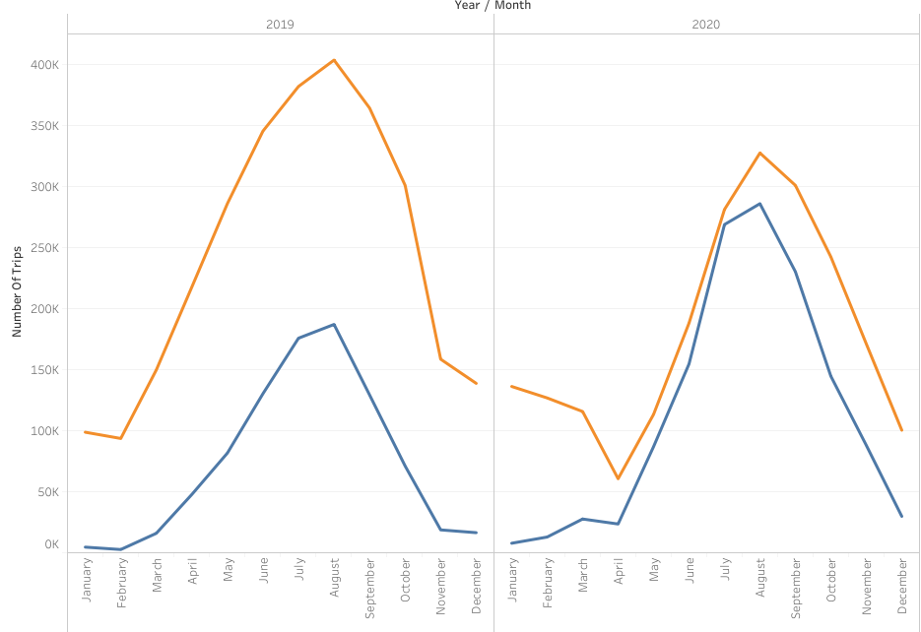
Appendix 2: Number of trips 2020
Number of Trips in 2019 and 2020

Slide 21
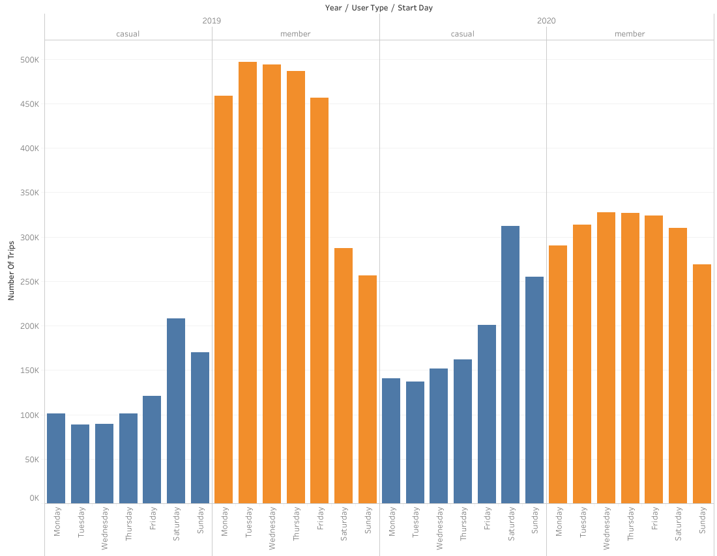
Appendix 3: Number of trips 2020
Number of Trips Per Weekday in 2019 and 2020

Slide 22
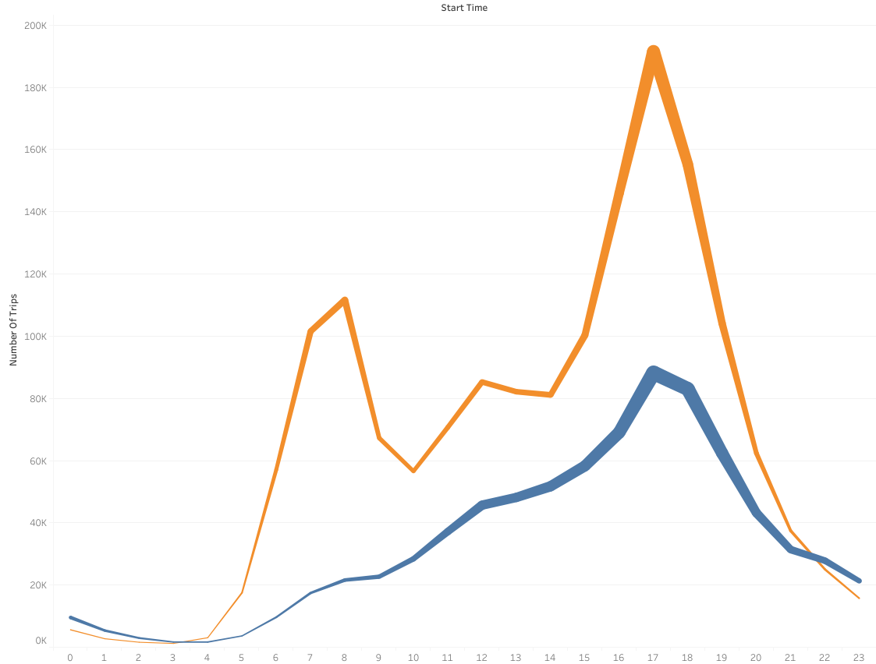
Appendix 4: Workweek usage 2020
Workweek Usage by Hour in 2019 and 2020

Slide 23
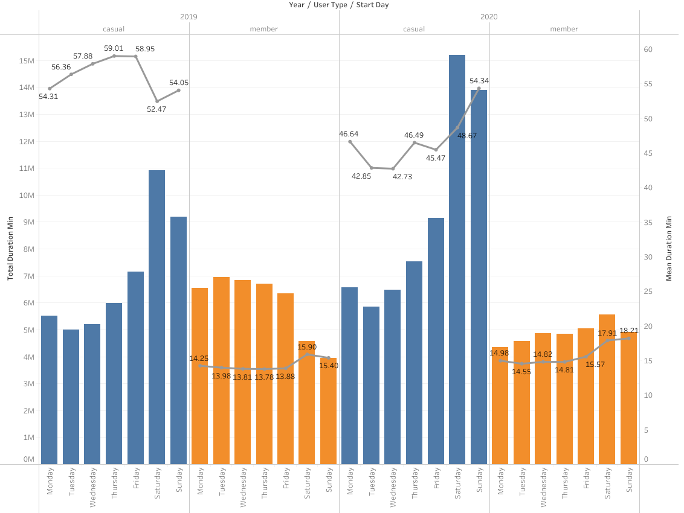
Appendix 5: Trip duration 2020
Total and Mean Trip Duration by day of the Week in 2019 and 2020

Slide 24
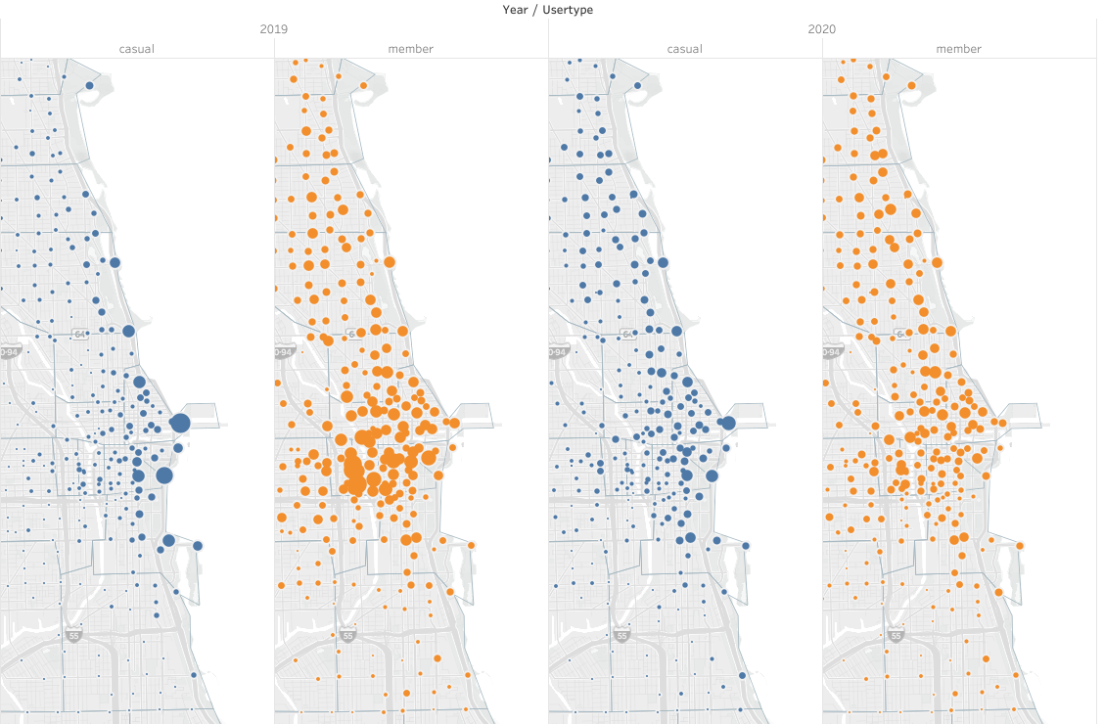
Appendix 6: Geographical distribution 2020
Location of Stations Where Trips are Being Started by User Type in 2019 and 2020

